Slide 1
Licking County Drug Overdose Prevention
October 2023

Slide 2
Above, the orange line represents the 4-year monthly average of confirmed ADOF from 2019-2022. The blue bars depict confirmed fatal overdose data for 2023. This data is confirmed by the Licking County Coroner’s Office (LCCO) and the Ohio Public Health Information Warehouse: Mortality Dataset. * Please note, this graph will be updated as toxicology reports become available.

Slide 3
The graph above shows the frequency of 2023 Cause of Death substances for accidental drug overdoses by Drug Classes from the DEA’s “Drugs of Abuse Resource Guide 2022 Edition”. Data is confirmed by the Licking County Coroners Office toxicology reports and does not reflect the total number of overdoses reported through ODMAP.
* Please note, this graph will be updated as toxicology reports become available.

Slide 4
The graph above shows the comparison of fentanyl-related and non-fentanyl-related accidental overdose fatalities. Data is confirmed by the Licking County Coroners Office toxicology reports and does not reflect the total number of overdoses reported through ODMAP.
* Please note, this graph will be updated as toxicology reports become available.

Slide 5
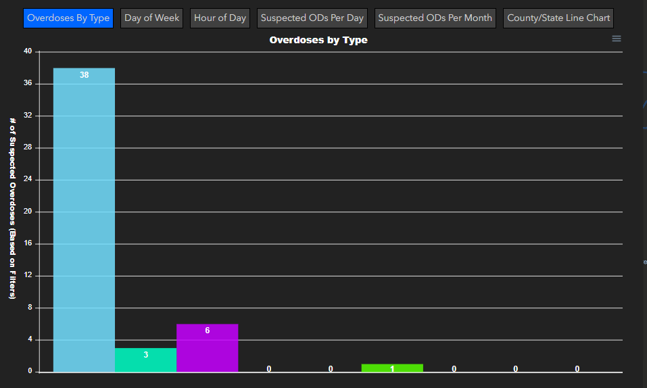
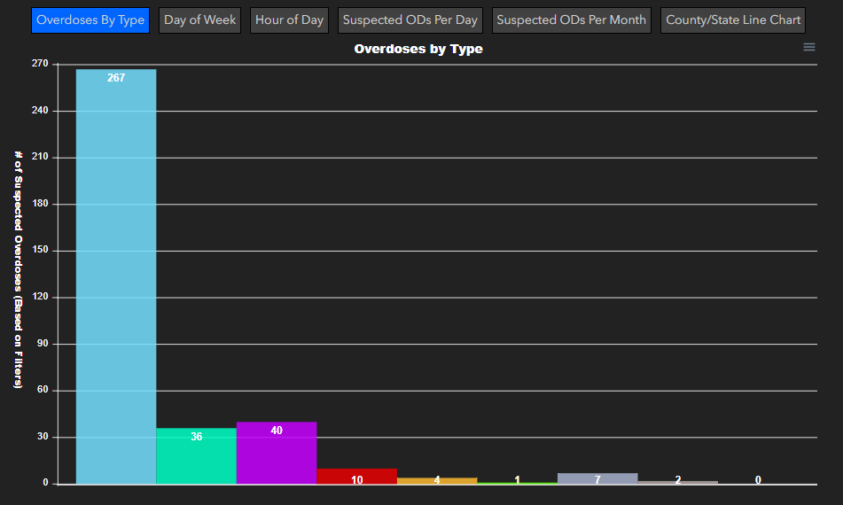
Licking County - ODMAP National Map Overdose Data
September 1, 2023 – September 30, 2023
January 1, 2023 – September 30, 2023

Slide 6
2023 Naloxone/NARCAN ® Distribution to date: 798
2022 Naloxone/NARCAN® Distribution: 1,019
2021 Naloxone/NARCAN® Distribution: 1,220

Slide 7
*The above graph depicts known Naloxone overdose reversals reported to the Licking County Health Department.
**This data does not include all Naloxone overdose reversals in Licking County.

