Slide 1
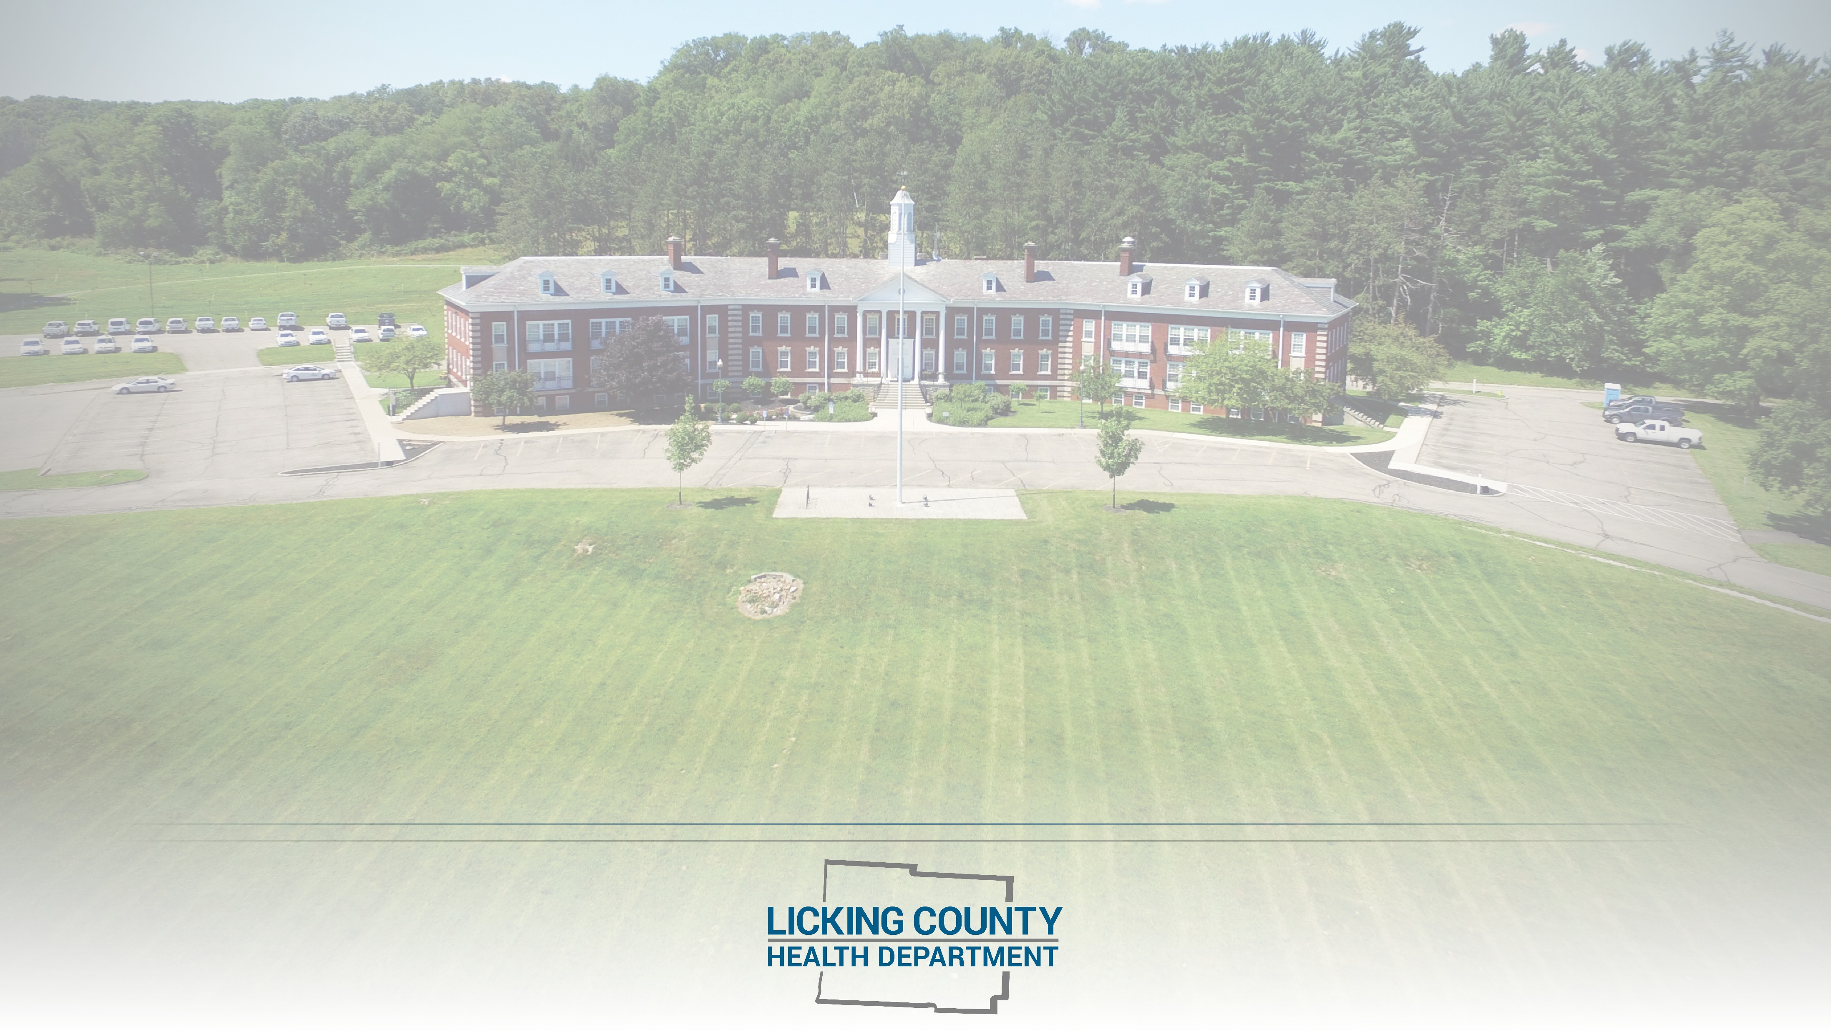
Licking County Health Department
COVID-19 Epidemiology Report
Published: May 18, 2022

Slide 2
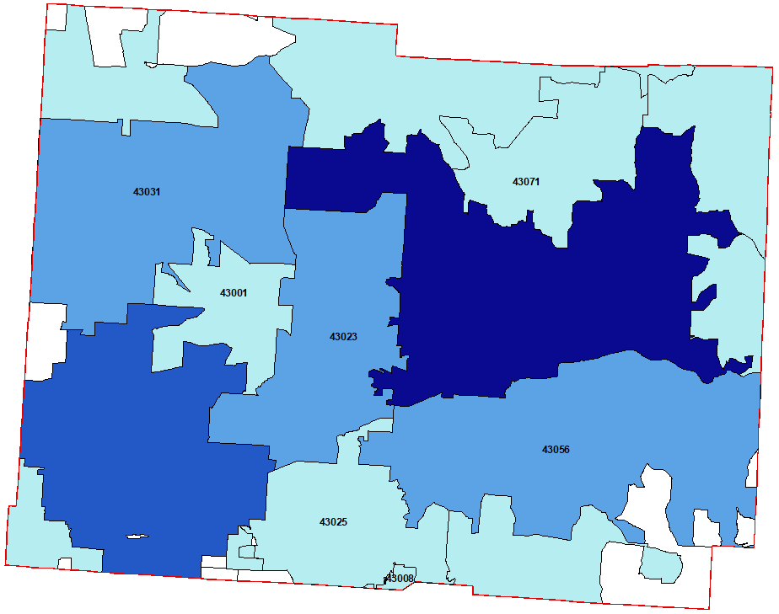
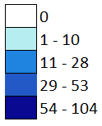
43011
43011
Zip Code Map is for all current ACTIVE COVID-19 cases.
Zip Code Mapping: The Licking County Health Department will publish zip code level data for COVID-19 cases belonging to the health jurisdiction once per week. Cases belonging to each zip code will be color coded based on the number of current active cases.
Zip Code Boundaries: Please take note, zip codes overlap county boundaries and LCHD is only mapping cases for each zip code that belong to the Licking County health jurisdiction. More cases may be present in a particular zip code but belong to another health jurisdiction.
Color Coding: Cases per zip code are being color coded with four different shades of blue. Lighter shades indicate fewer cases and increase with darker shades of blue. Zip codes labeled white do not have cases within the Licking County health jurisdiction.
*Some of the smaller zip codes and those along the border could not be mapped. Please reference the table on the next slide for any missing zip codes.
**Nursing home residents have been excluded from this map.
43013
43080
43822
43055
43830
43054
43062
43018
43068
43033
43076
43046
43739

Slide 3
43011
43011
43013
43080
43822
43031
43055
43830
43054
43062
43018
43068
43033
43076
43046
43739

Slide 4
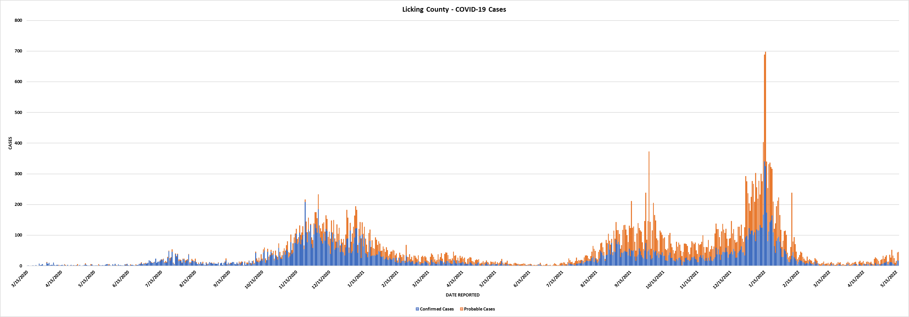
Trend Graph – Confirmed and Probable COVID-19 Cases

